Slide 1

Customer Shopping Behavior Analysis
Analysis of 3,900 transactions to reveal spending patterns, product preferences, segments, and subscription behavior to inform strategic decisions.

Slide 2
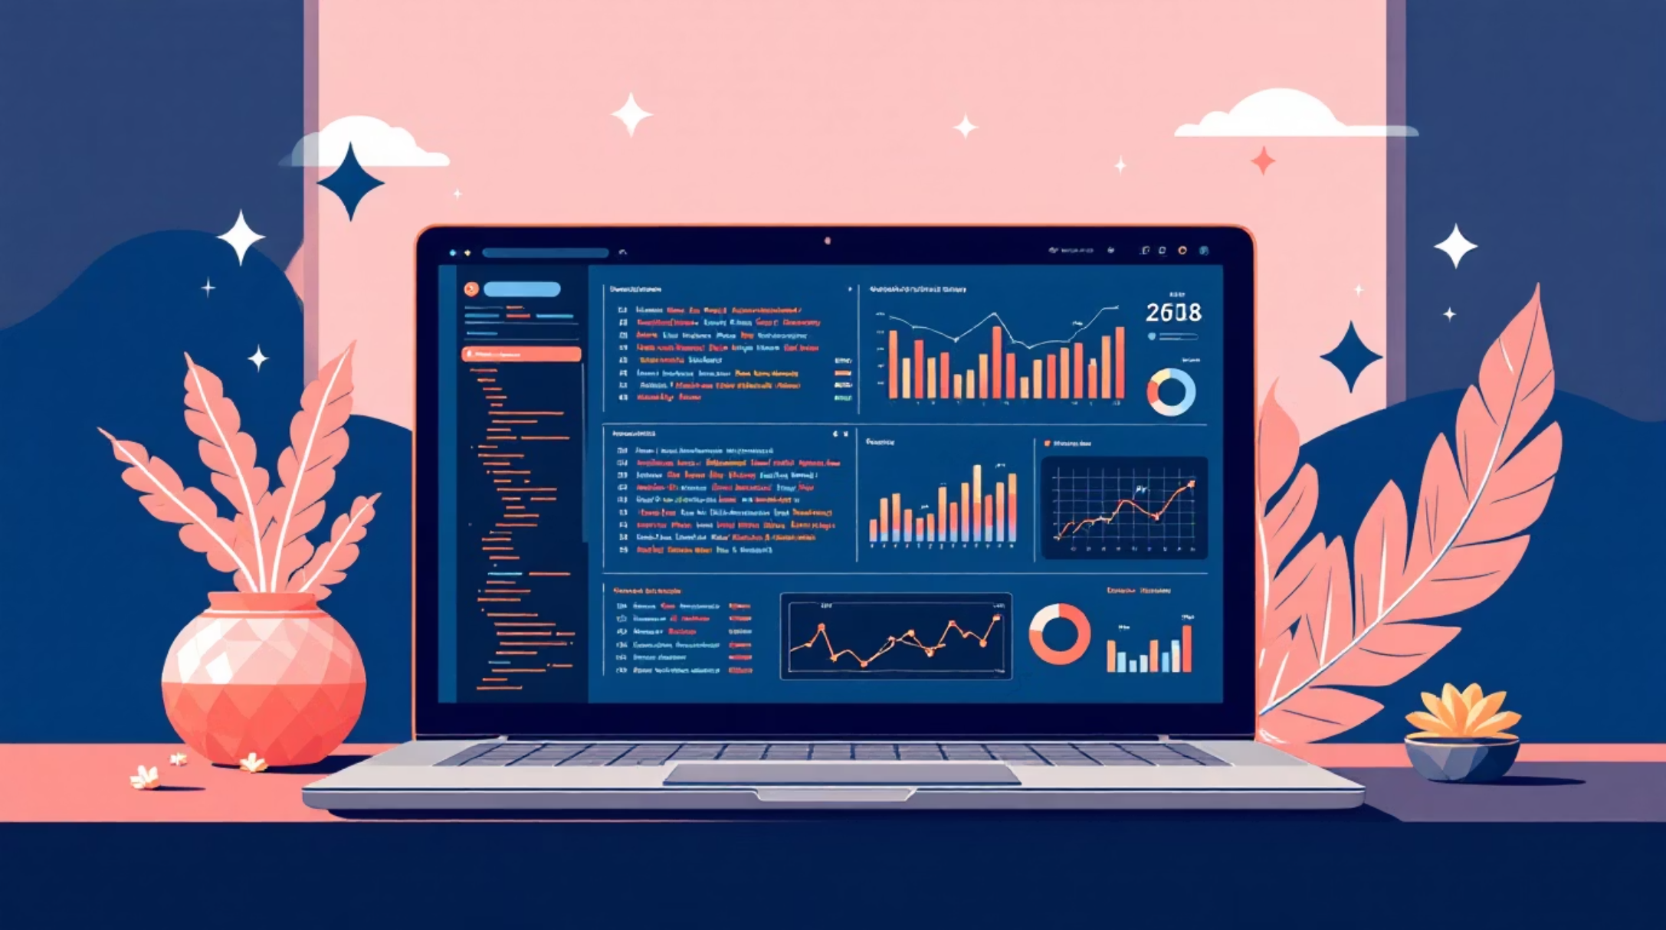
Dataset Snapshot
Summary
Rows: 3,900 • Columns: 18. Key features include demographics, purchase details, behavior flags, and shipping. 37 missing values in Review Rating.
Avg purchase: $59.76
Avg rating: 3.75
Most common shipping: Free Shipping

Slide 3

Data Preparation (Python)
Loading & Explore
Missing Data
Standardize & Engineer
Imputed Review Rating using median per product category (37 nulls).
Imported with pandas; used df.info() and .describe() for structure and stats.
Renamed columns to snake_case; added age_group and purchase_frequency_days.
Integration
Connected cleaned DataFrame to PostgreSQL for SQL analysis.

Slide 4
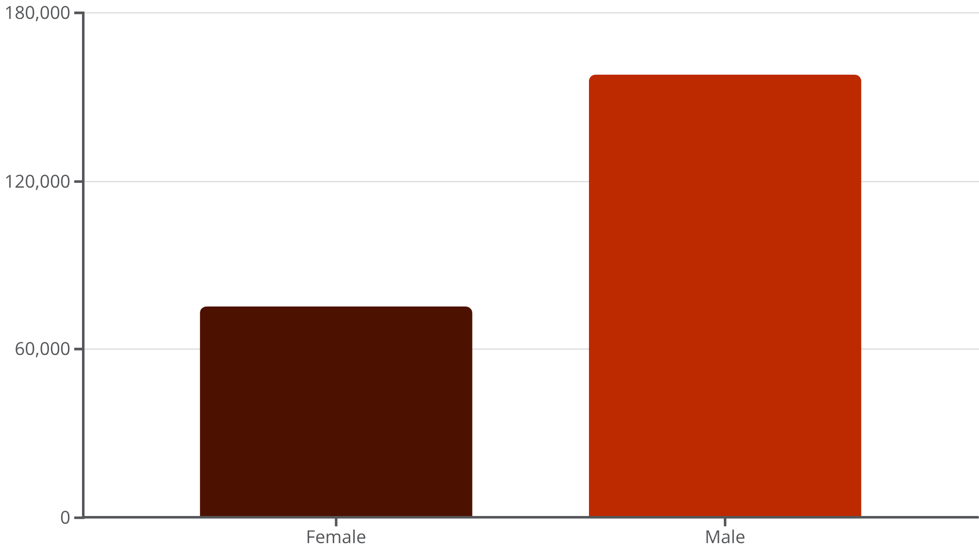

Revenue by Gender
Total revenue is skewed toward male customers (157,890 vs. 75,191). Use this to refine targeting and assortments.

Slide 5





Top Products & Ratings
Gloves
Sandals
Boots
Hat
Avg rating: 3.86 — top-rated item.
Avg rating: 3.84.
Avg rating: 3.82.
Avg rating: 3.80.
Skirt
Avg rating: 3.78.
Highlight top-rated and best-selling products in campaigns to leverage positive sentiment.

Slide 6

Shipping & Spend Comparison
Average purchase by shipping type:
Standard: $58.46
Express: $60.48
Express buyers spend slightly more—consider targeted promotions for faster-shipping segments.

Slide 7

Subscribers vs Non-Subscribers
Metrics
Subscribers: 1,053 avg spend $59.49, total revenue $62,645. Non-subscribers: 2,847 avg spend $59.87, total revenue $170,436.
Only 27% subscribe—opportunity to grow recurring revenue with improved benefits.

Slide 8




Customer Segmentation & Repeat Buyers
Repeat buyers are a large portion of customers—focus loyalty programs to convert Returning → Loyal and retain top buyers.
Loyal
3,116 customers
Returning
Encourage repeat purchases
New
83 customers
New
Loyal
Acquire first-time customers
Reward and retain top buyers
Segmentation supports targeted retention strategies.
Returning
701 customers

Slide 9
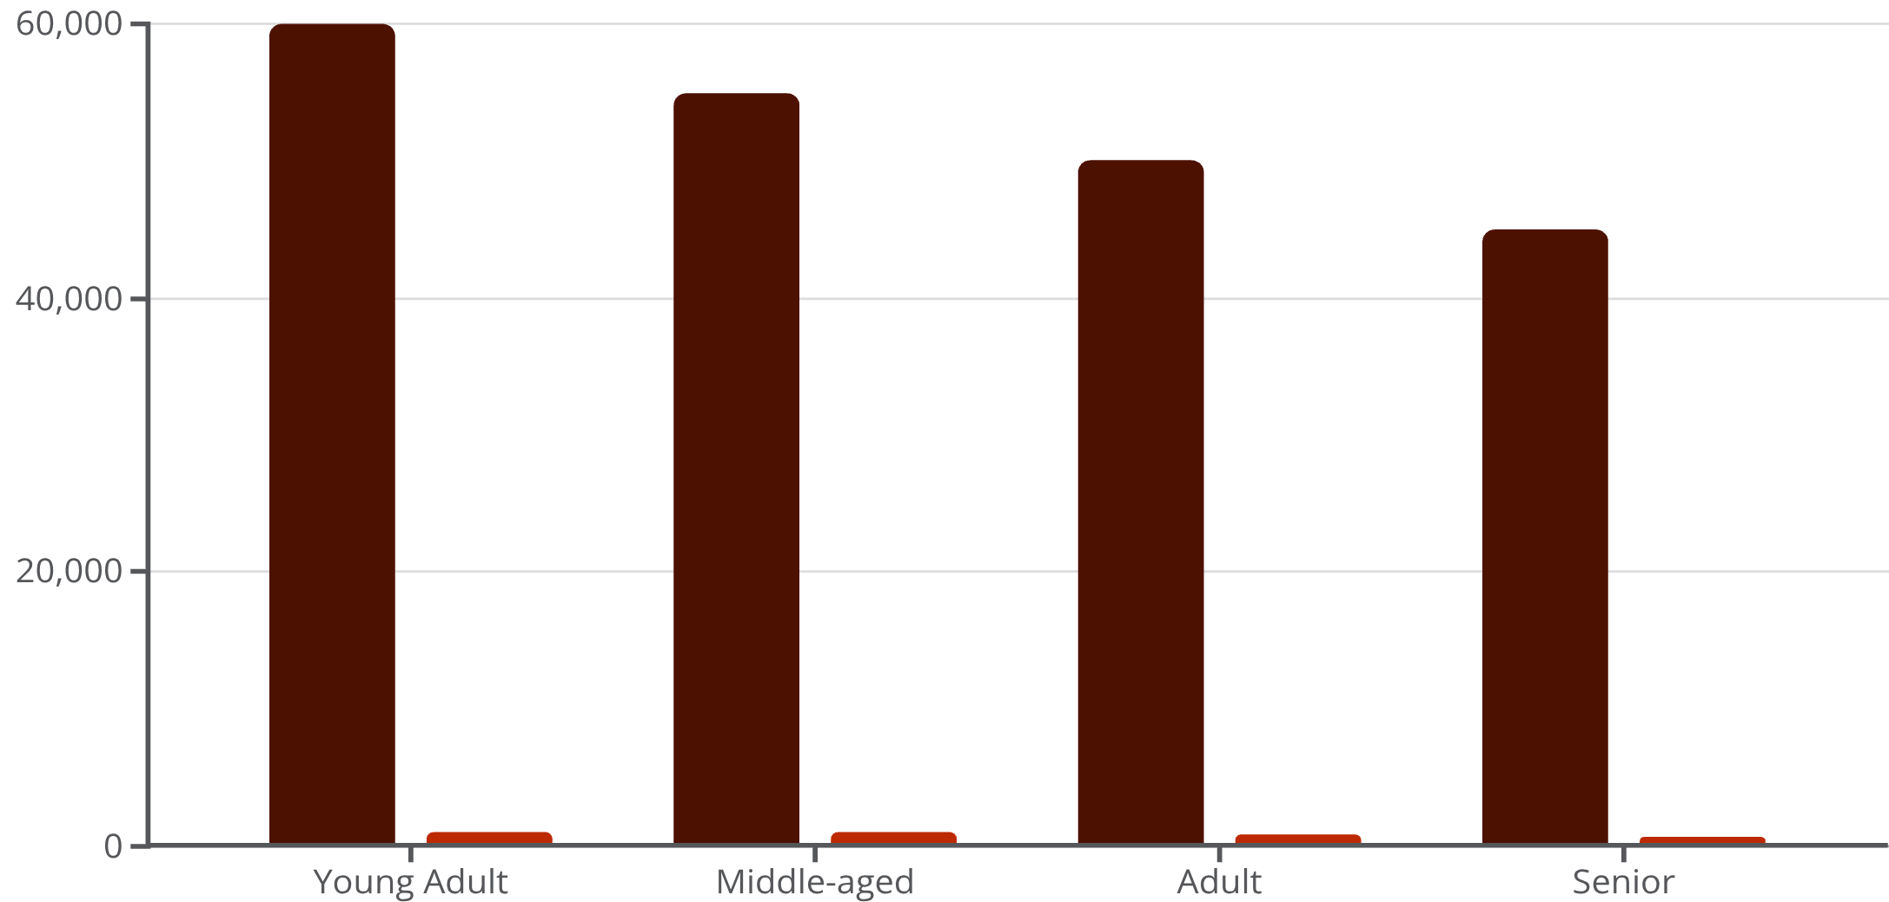
Revenue & Sales by Age Group
Young Adults drive the highest revenue and sales. Prioritize targeted marketing and product positioning toward high-revenue age groups.
Revenue
Sales

Slide 10
Recommendations & Next Steps
Boost Subscriptions
Reward Loyalty
Review Discount Policy
Promote exclusive benefits to increase the 27% subscriber base.
Launch programs to move repeat buyers into the Loyal segment.
Balance discount-driven sales with margin protection—focus on discount-dependent products.
Product Positioning
Targeted Marketing
Feature top-rated and best-selling items in campaigns for higher conversion.
Focus on high-revenue age groups and express-shipping users with tailored offers.
Deploy recommendations via the Power BI dashboard to track progress and measure impact.

